Slide 1

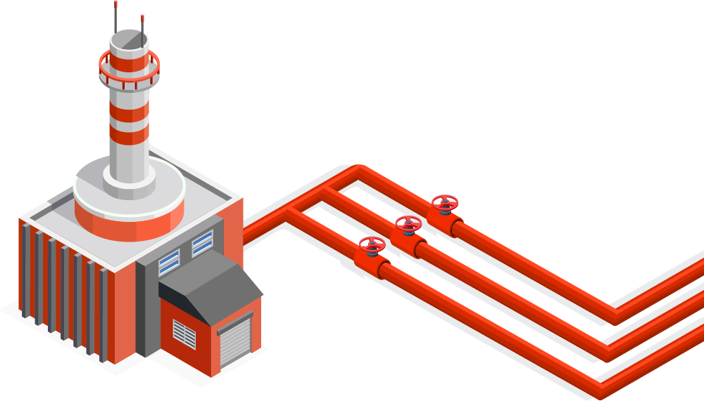
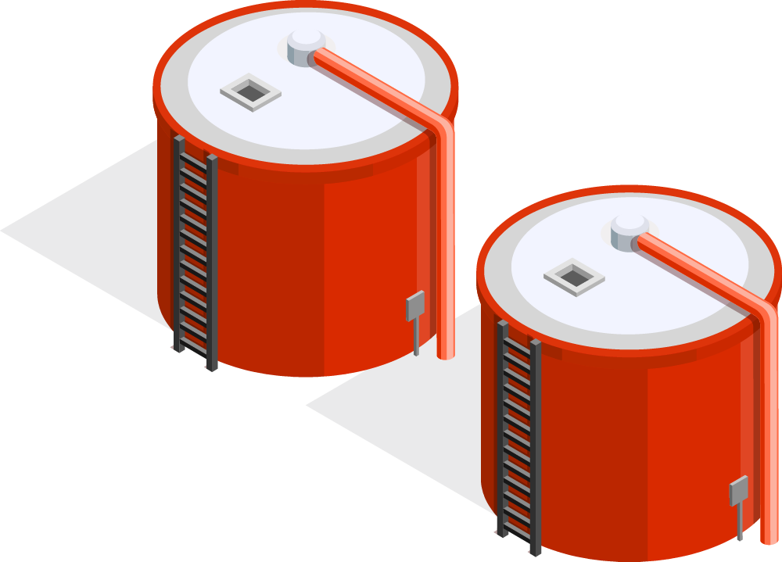
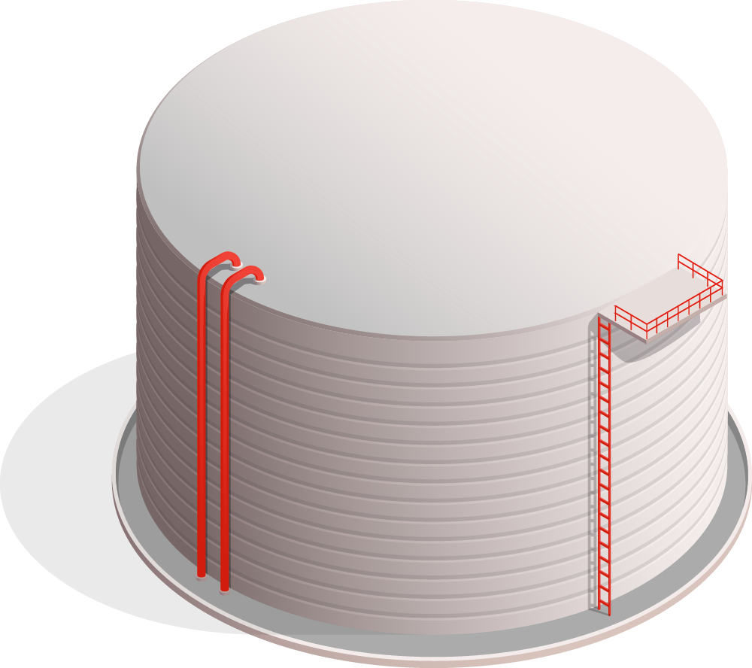
Sources of Renewable Energy
Karan Sunil Kumbhar
12140860

Slide 2
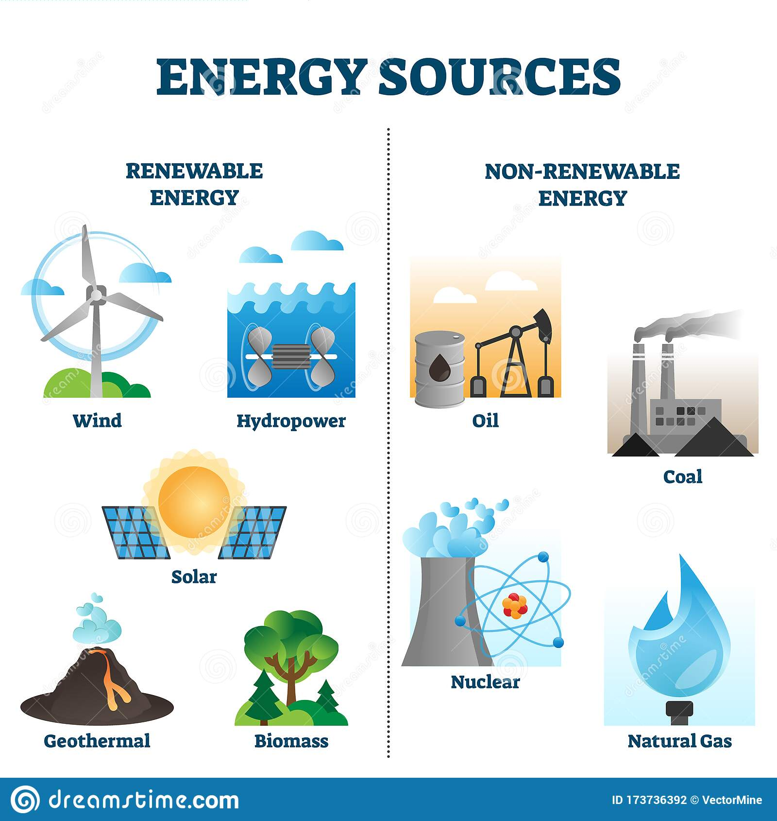
Common Source of Energy

Slide 3
Exploding Lakes
Body Heat
Carbon Nanotubes
Jellyfish
Solar Wind
Sludge
Unusual Alternative Energy Sources
Vibrations
Bacteria

Slide 4
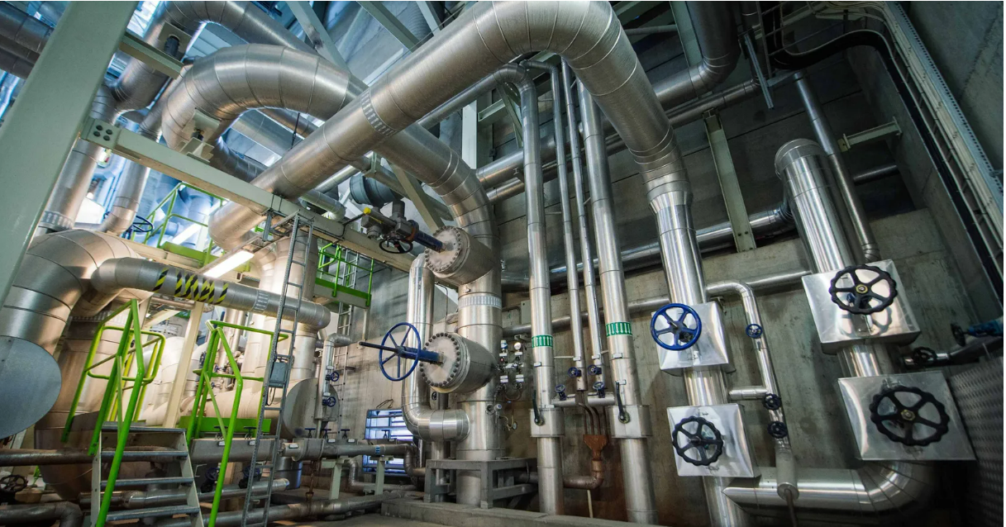

The heat your body produces can warm an entire building.
Body Heat
The heat through train communators captured by district heating system.
This ordinary-looking building in Paris gains much of its heat supply from a nearby metro station

Slide 5


Jellyfish
Glow produced by green fluorescent protein(GFP)
Drop of GFP placed onto aluminum electrodes and then exposed that to UV light. The protein released electrons, which travel a circuit to produce electricity
Same proteins have been used to make a biological fuel cell,which makes electricity without an external light source
Chalmers University of Technology , Gothenburg

Slide 6
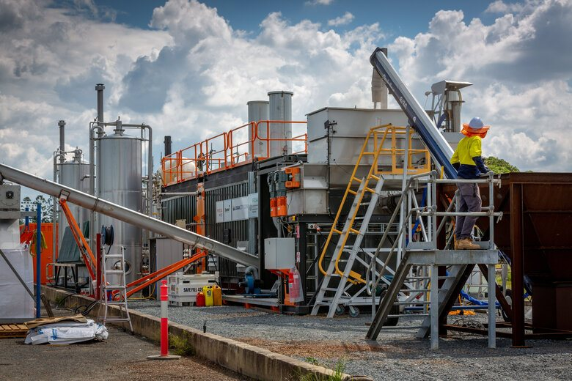
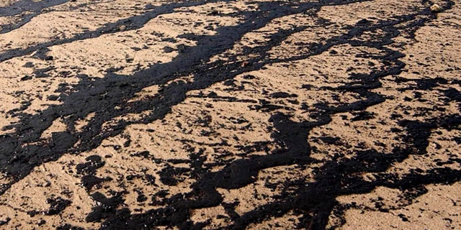
Sludge
700,000 metric tons of dried sludge , has the potential to generate 10 million kilowatt-hours of electricity per day.
Drying sludge make it burnable for a gasification process, which turns it into electricity
Compared to conventional energy generation from fossil fuels, sewage sludge emits 58% less GHG emissions than CHP units on natural gas and 80% less emissions than hard coal power plant
The University of Nevada, Reno

Slide 7

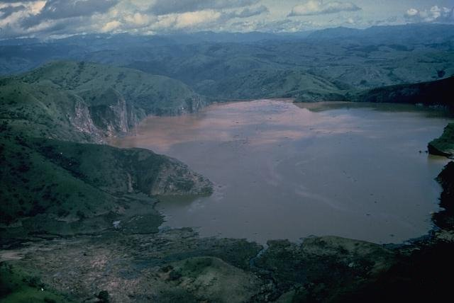
Exploding Lakes
Contain huge reservoirs of methane and carbon dioxide trapped in the depths
There are three known "exploding lakes," in
the world - Lake Kivu, Lake Monoun, and
Lake Nyos.
Power plants sucks up the noxious gases from
the lake to power three large generators,
which produce electricity

Slide 8
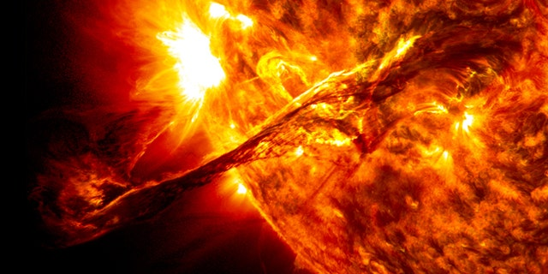
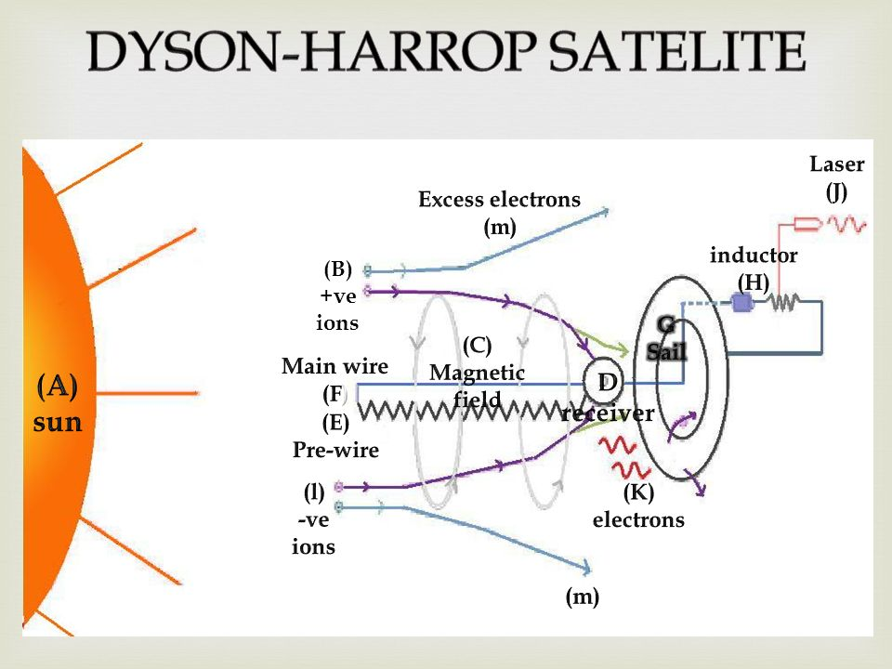
Solar Wind
One hundred billion times more power than humanity currently needs is available right now, out in space
so-called Dyson-Harrop satellite would have a long copper wire charged by onboard batteries in order to produce a magnetic field perfect for snagging the electrons in the solar wind. The energy from the electrons would be beamed from the satellite via a infrared laser to Earth

Slide 9
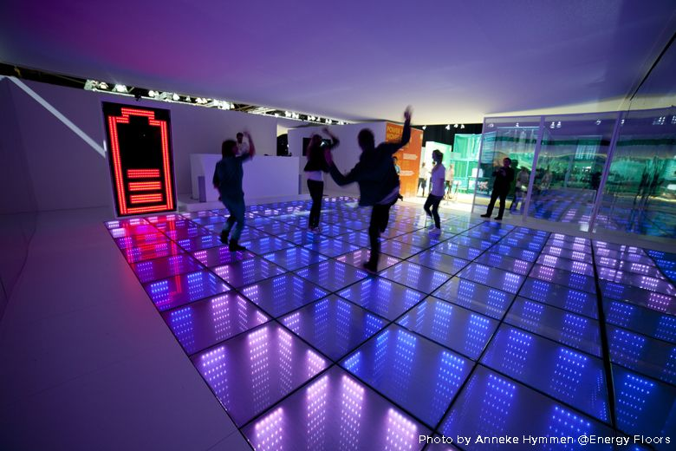
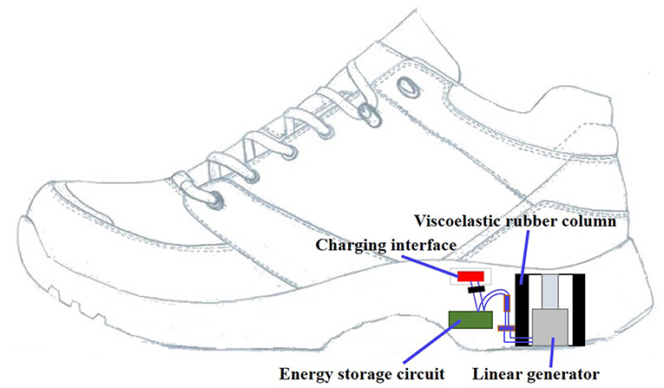
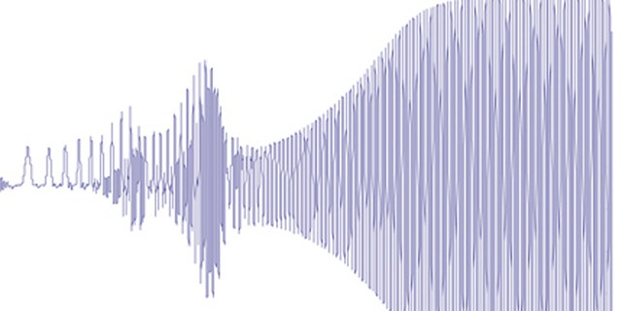
Vibrations
The vibrations are captured by “piezoelectric” materials that produce an electric change when put under stress
Club Watt in Rotterdam, Netherlands is using floor vibrations from people walking and dancing to power its light show
The U.S. Army is also looking at piezoelectric technology for energy. They put the material in soldier’s boots in order to charge radios and other portable devices.

Slide 10
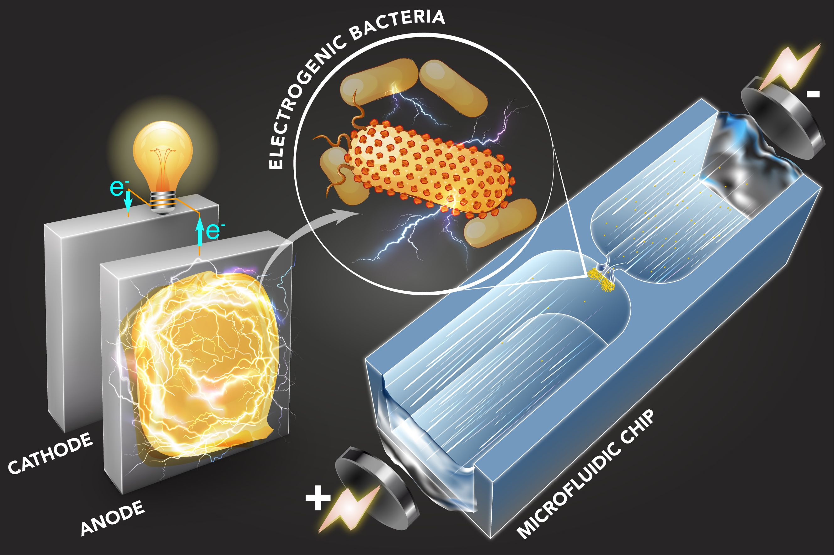
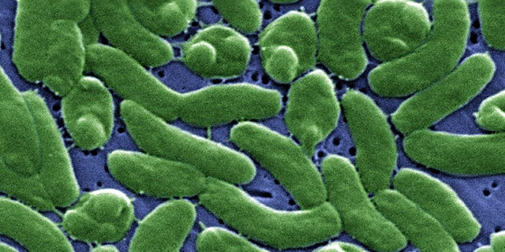
Bacteria
E. coli bacteria store fuel in the form of fatty acids that resembles polyester.
same fatty acid is needed for the production of biodiesel fuel.
The scientists removed enzymes from the bacteria to boost fatty acid production, and then dehydrated the fatty acid to get rid of the oxygen, which made turned it into a type of diesel fuel

Slide 11
Thank you!
Do you have any questions?
References:-
https://theecologist.org/2019/oct/29/worlds-strangest-sources-renewable-energy
https://www.bbc.com/future/article/20200908-the-buildings-warmed-by-the-human-body
https://www.foxnews.com/science/11-bizarre-sources-for-alternative-energy
https://www.dreamstime.com/energy-sources-vector-illustration-collection-infographic-other-environment-related-content-graphical-assets-renewable-versus-image173736392

